Slide 1
Reading and Writing in KS2
What you need to know and how you can help your child

Slide 2
Are you sitting comfortably?
Then I’ll begin…with reading.
Notes:
Humans are hotwired to communicate, but not to read marks on a page and translate them into words then images. Sentence structure!

Slide 3
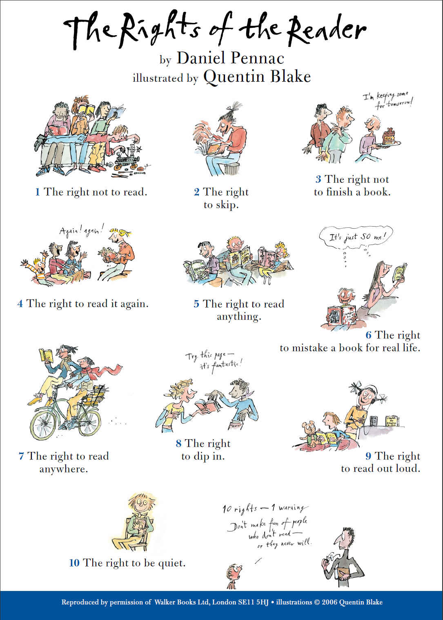

Slide 4
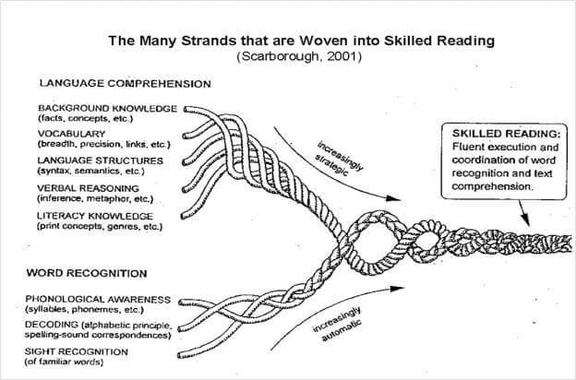
Reading is not easy or natural!

Slide 5
Fluency
The need for speed!
If it takes a … a child a long time to read a … paragraph of text….
by the time they … come to the end of it…they will have …forgotten the …beginning.
Would you keep reading a book if you forgot what you had just read?
This is why it is essential to that children are reading a
Notes:
Most adults read between 200 and 300 words per minute.
Children need to reach 100 wpm by the end of KS2.

Slide 6
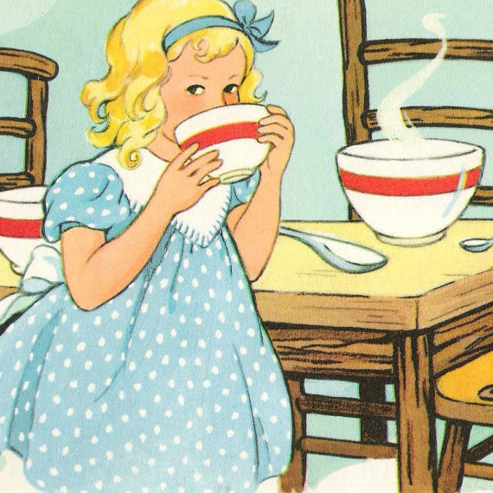
Does your child have a Goldilocks book?
Too easy
You have read it lots of times
You know all of the words
You can read it smoothly and quickly
Too hard
You are not interested in the subject
You are often confused about what is happening
Even when you re-read parts of it, you don’t really understand it
You need a lot of help to read it
Notes:
Evidence in class – someone has the same book for ages but can’t talk to you about it
A child changes their book all the time, but doesn’t have a favourite

Slide 7
How you will know if it’s a ‘just right’ book
Just right (Goldilocks)
You know most (95-97% of the words)
You can read it smoothly, but some parts are a bit choppy
You might need to re-read parts to understand them
Notes:
On a page with a hundred words, you might not know 3 or 5. Encourage post its at home – don’t interrupt reading to discuss. Wait til the end of a paragraph or chapter to recap.

Slide 8
Teachers need your help
In KS2 approximately one hour a day might be spent reading.
That’s only 5 hours a week…
You could nearly double that figure with 30 minutes a night and an hour on Saturday and Sunday.
Most children in England do not read on a daily basis: in 2011 just over a third (37%) of 10 year-olds surveyed reported reading for pleasure every day.
There is a difference in reading performance equivalent to just over a year's schooling between young people who never read for enjoyment and those who read for up to 30 minutes per day
Notes:
Be clear that this relates just to reading from a text (we read all the time in terms of looking at board/reading maths, RE etc

Slide 9
Comprehension
Talk to your child as much as you can.
Much of what we comprehend comes from our ability to make links with what we already know.
The more you read, the more you’ll know.
The more you’ll know, the more places you’ll go.
Dr Seuss
Notes:
Activating prior knowledge
How to avoid one word responses: What was the best thing that happened at school today (the worst).

Slide 10
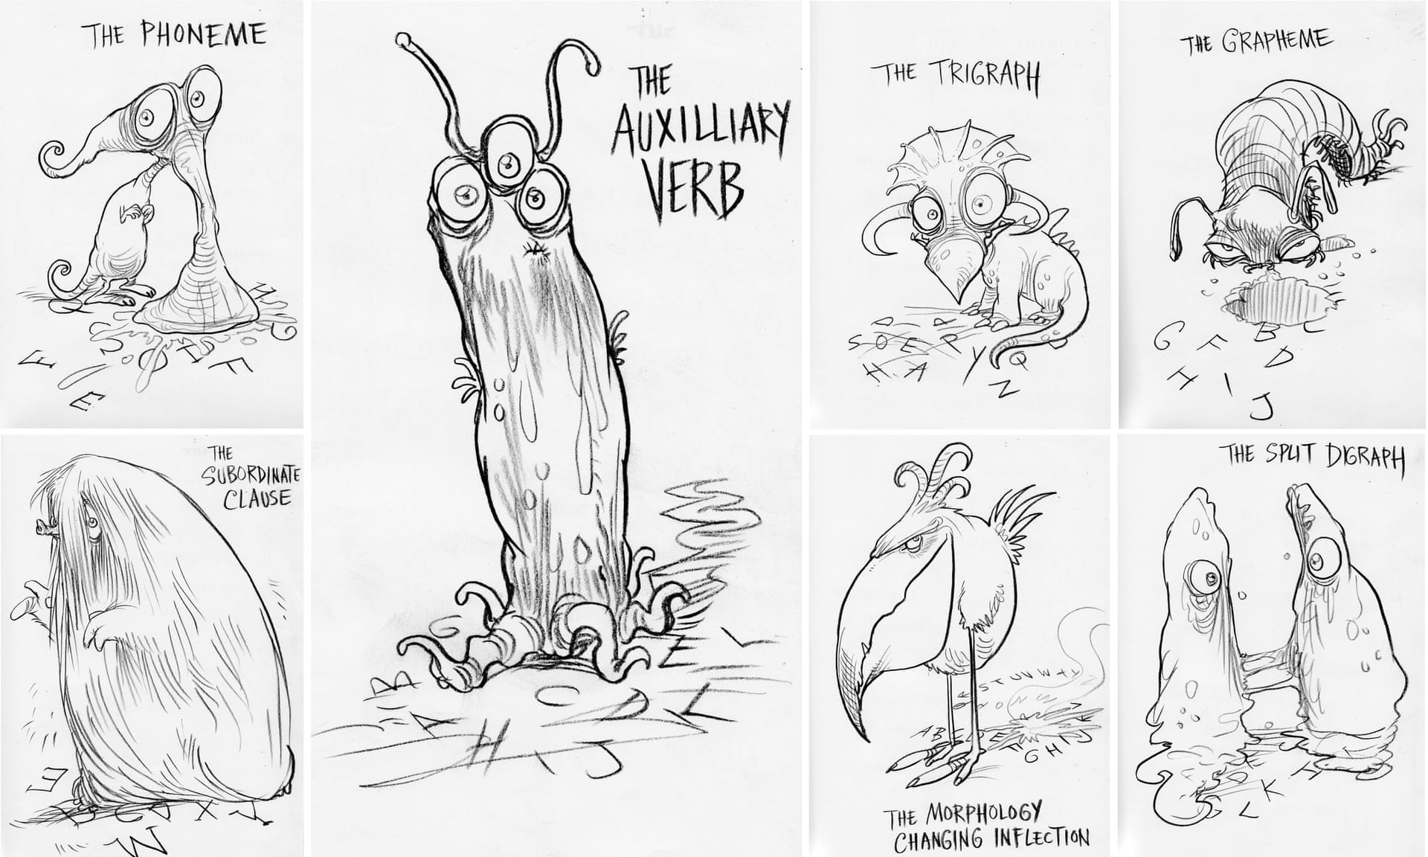
Progression in Grammar
Notes:
Terminology has become important.
Each year children deepen understanding of sentence structure.

Slide 11
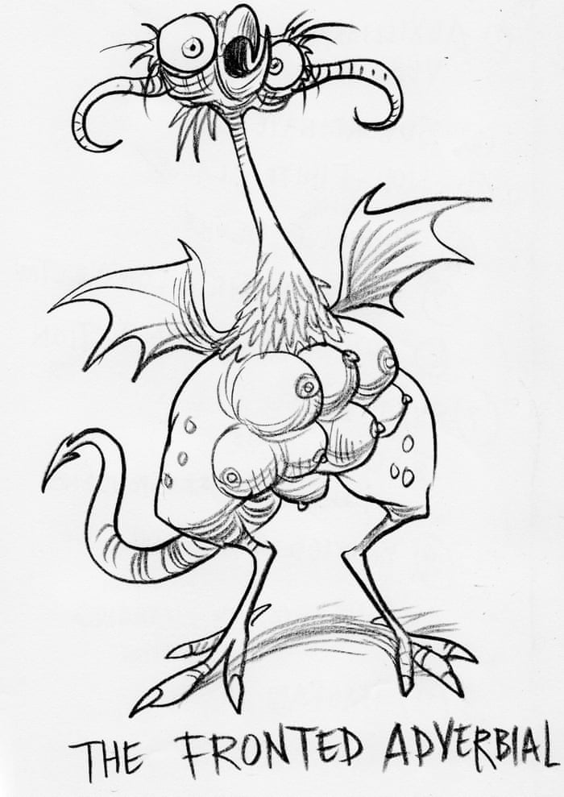
Grammar Terminology
Nouns, verbs, adjectives, adverbs, pronouns
Determiners (used to be articles): the, a , an
Clauses and phrases (relative clauses)
Conjunctions (co-ordinating, subordinating)
Fronted adverbials (time, place, manner)
Prepositions
Modal verbs
Notes:
Give a few minutes to look at your child’s year group in the Grammar handout.

Slide 12
Punctuation – and editing for it!
Capital letters
. , ! ? – ( ) “
Year 3 – direct speech, plural possessive apostrophes
Year 4 – direct speech with reporting clause first AND commas after fronted adverbials
Year 5 – commas for cohesion AND use of commas, brackets or dashes to show parenthesis
Year 6 – colons and semi colons

Slide 13
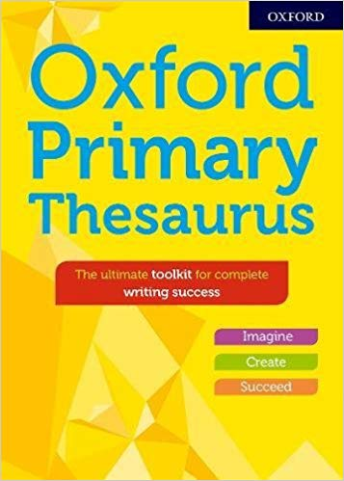
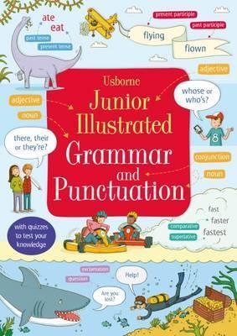

Slide 14
Spelling terminology
Using sounds (recognising the phonemes for each grapheme)
Special friends
Prefixes
Suffixes
Root words
Word families
Etymology
Notes:
See Reception powerpoint for more help on phonics.

Slide 15
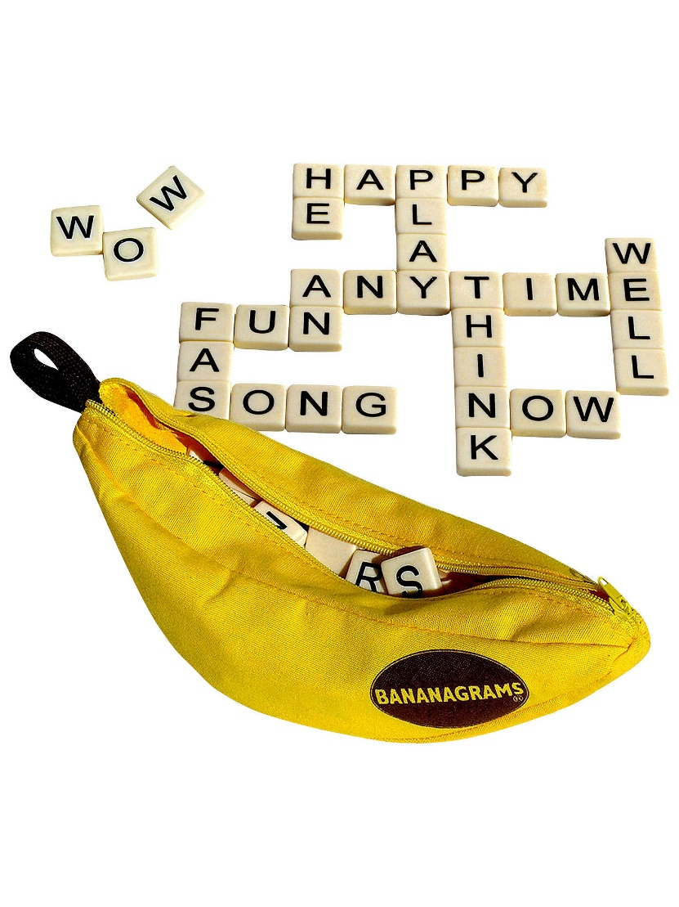
Spelling Games
Make spelling fun!
Bananagrams
How many words?
Hangman
Scrabble
Boggle
Crosswords
Make connections
Mnemonics

Slide 16
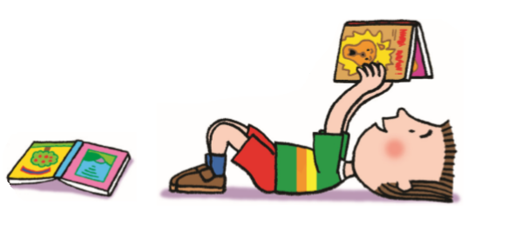
Vocabulary
There are over a million words in the English language.
If a child is a good reader at 10, they will read approximately 100,000 words a year.
By KS3, if a child has not developed a good range of vocabulary, they will find it very hard to access the academic language needed for GCSE
In short, your child’s current reading habits are likely to affect their future
A knowledge of around 50,000 words is needed to gain a University qualification
Notes:
Average adults know/use between 20,000 and 50,000 (with a BA)

Slide 17

How do we teach English at SWOY?
This is a literacy scheme promoted by the Centre for Literacy in Primary Education
Many of the texts we use for Reading and Writing are recommended by POR
They are inspirational books that link with our topics (either history, geography or science)
The texts are chosen to help stimulate interest and encourage writing.
Children will study the text for 2-3 weeks, using new vocabulary and techniques in their writing.

Slide 18

Tips for Handwriting
1,2, 3, 4 Are my feet flat on the floor? (Encourage posture, pencil grip, paper position at home too)
Try a triangular or soft grip pencil
Practice drawing the shapes in the air, in a sand tray etc
Remind child to begin and on the line
Cross t and dot i at the end of the word
There should be a oo space between words

Slide 19
Any Questions?
www.booktrust.org
www.lovemybooks.org
http://www.wordsforlife.org.uk/
swebster@swoy.lewisham.sch.uk
Notes:
Please get in touch with me if you would like more information or advice on reading or writing.

