Slide 1
Reading and Writing in KS1
What you need to know and how you can help your child

Slide 2
Year 1 and 2
Learning to Read: Phonics – Read Write Inc
Writing: Handwriting and Content
Supporting at home

Slide 3
Learning to Read
Phonics: Read Write Inc

Slide 4
Progression in Phonics Year 1
Set 1 sounds (recapped from Reception) Pure sounds
Set 2 & 3 sounds
Blending sounds (Fred Talk)
Reading words (Fred in your head)
Regular assessments and regrouping each half-term
Progression through Books
Black and White books for home
Phonics Screening Test usually takes place in May of Year 2

Slide 5
Other Reading in Year 1 and 2
Story time – every day in class
High quality texts taught in English and other lessons
Book Packs – include a phonics book and a Reading for Pleasure book to share with your child at home.

Slide 6

Reading at home
Read books together
Tell each other stories
Chat about the things you have read
Talk about the pictures in the book
Share stories without a book – retell favourite ones

Slide 7

Why read at home?
Reading helps your child
To understand the world around them
Develop social and emotional skills
Improve at English, Science, Maths and other subjects
Build confidence with communication
Strengthen their bonds with you and other family members

Slide 8
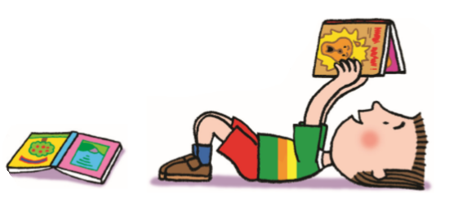
Tips for Reading
Find a quiet place with no distractions
Take time to look at each page
If your child is reading to you, don’t correct every mistake
Let them talk to you about the pictures
Give lots of praise and encouragement
Discuss the meaning of new words
Don’t worry if a child chooses the same book

Slide 9

The Power of Reading (POR)
This is a literacy scheme promoted by the Centre for Literacy in Primary Education
All of the texts we use for Reading and Writing are recommended by POR
They are inspirational books that link with our topics (either history, geography or science)
The texts are chosen to help stimulate interest and encourage writing.
Children will study the text for 2-3 weeks, using new vocabulary and techniques in their writing.

Slide 10
Writing in Year 1 and 2
Handwriting
Grammar
Spelling

Slide 11
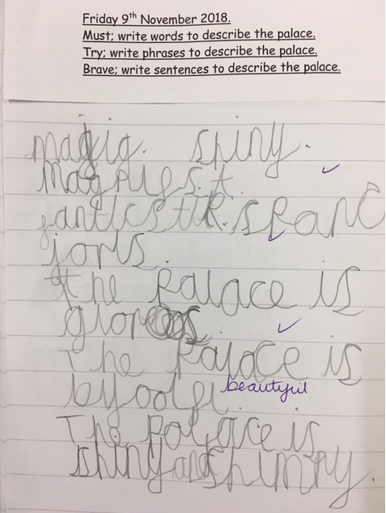
Writing in Year 1
Form letters in the correct direction
Write sentences to make short stories
Use capital letters and full stops in some writing
Begin using ? and !

Slide 12
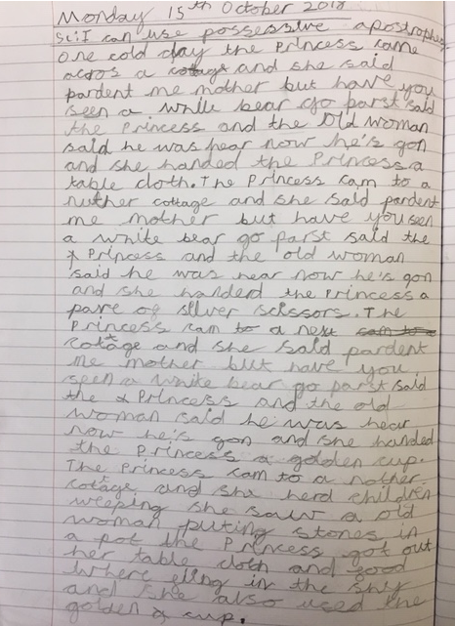
Writing in Year 2
Use simple past, present and progressive tenses
Capital letters, lower case letters and digits are the correct size and relation to each other
Sentences are more complex – using conjunctions
Adjectives used to make noun phrases
Editing and improving begins
Commas in lists
Apostrophes for contraction and singular possession

Slide 13
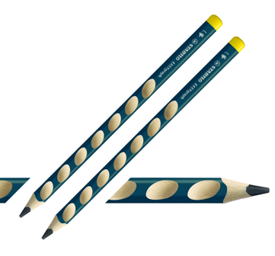
Tips for Handwriting
1,2, 3, 4 Are my feet flat on the floor? (Encourage posture, pencil grip, paper position at home too)
Try a triangular or soft grip pencil
Practice drawing the shapes in the air, in a sand tray etc
Remind child to begin and on the line
Cross t and dot i at the end of the word
There should be a oo space between words

Slide 14
Spelling
In Year 1
Phonetically plausible using sounds taught
Exception words
In Year 2
Spelling Appendix
Exception words
How can you help?
Know the sounds (Fred fingers)
Speed write
Games (hangman)
Mnemonics (because)
Read!

Slide 15
Any Questions?
www.booktrust.org
www.ilovebooks.org
http://www.wordsforlife.org.uk/
swebster@swoy.lewisham.sch.uk

